Slide 1
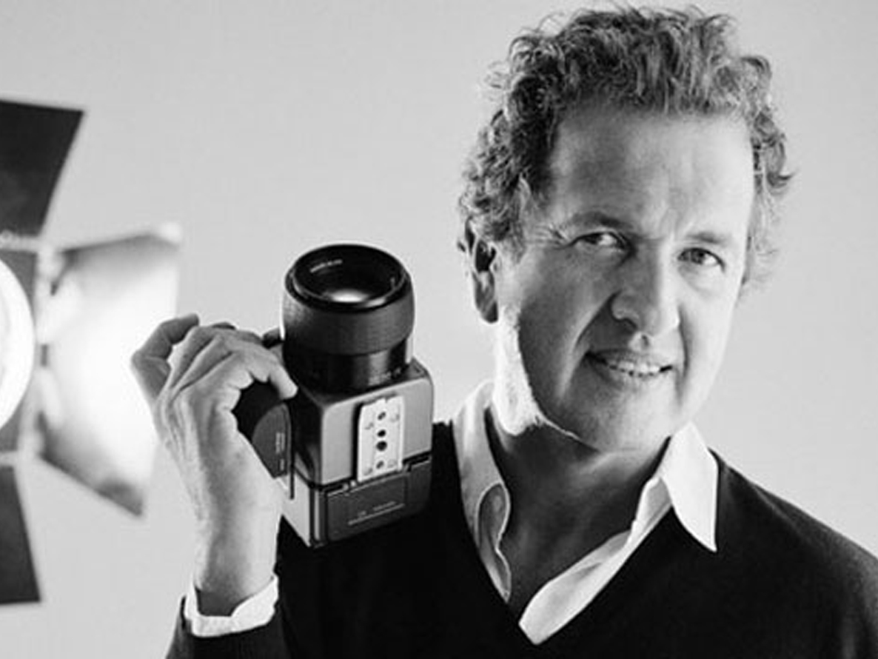
Mario Testino
Celebrity photographs in Black and White
Notes:
Mario Testino is 60 years old and grew up in Peru. He moved to London when he was 21 and found digs in a boarding house, which cost him £10 a week. He found it difficult to earn enough though his photography to make ends meet and has said that the ability to take great photographs was a long time in coming.

Slide 2
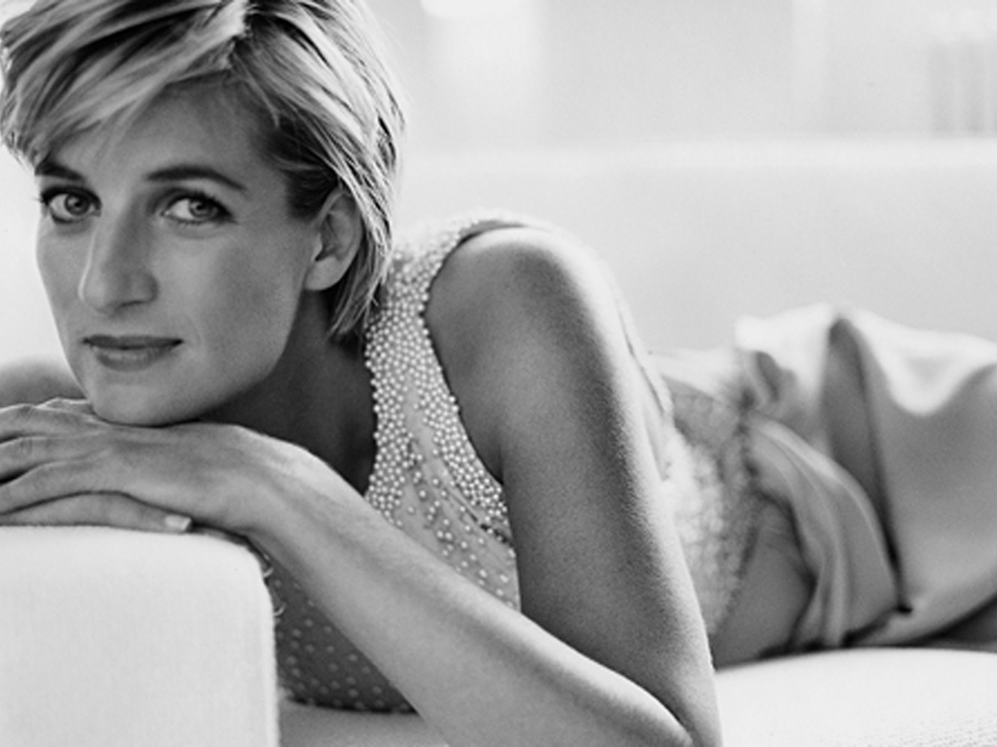
Princess Diana - 1997
Notes:
He has now been a photographer for over 30 years and his biggest break came in 1997 when Princess Diana picked him to do a photo shoot of her for the cover of Vanity Fair. This is one of a fantastic series of photographs. Later, Diana was to recall that the shoot with Mario Testino, as ‘One of the happiest days of my entire life’.

Slide 3
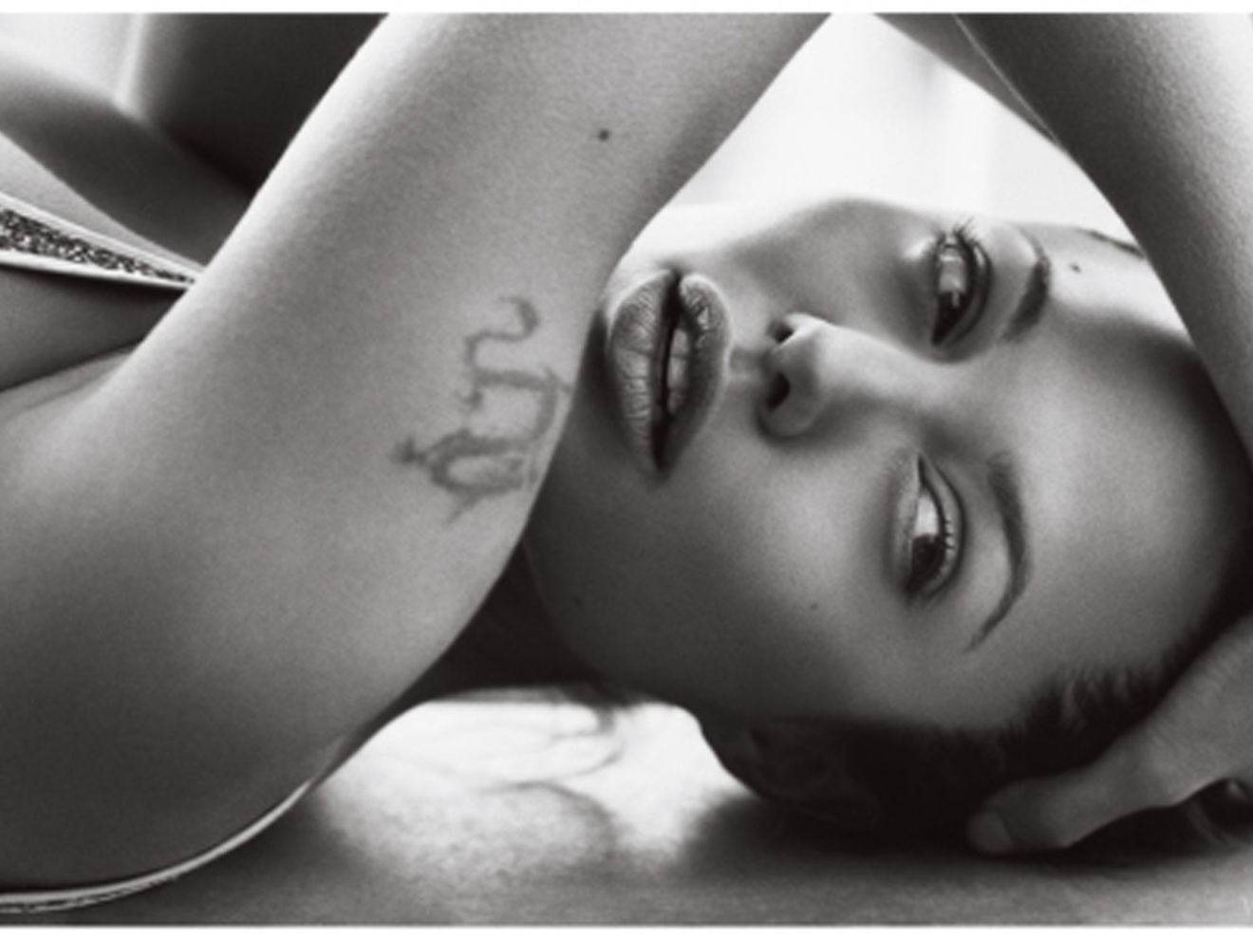
Angelina Jolie - 2004
Notes:
Since then he has photographed many A list stars.

Slide 4
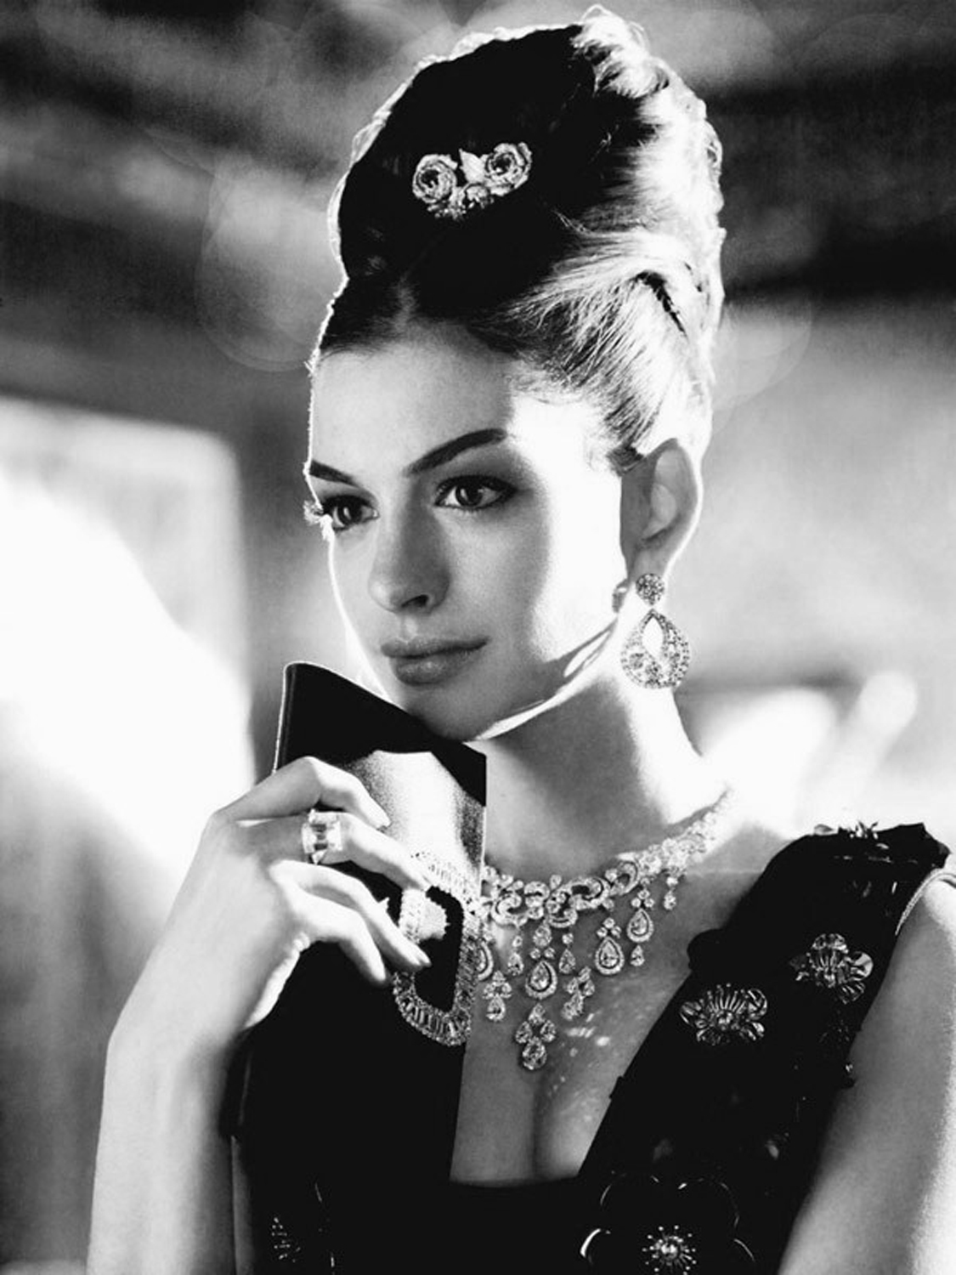
Notes:
Who do you think that is? Not Audrey Hepburn, but Anne Hathaway for US Vogue in 2010.

Slide 5
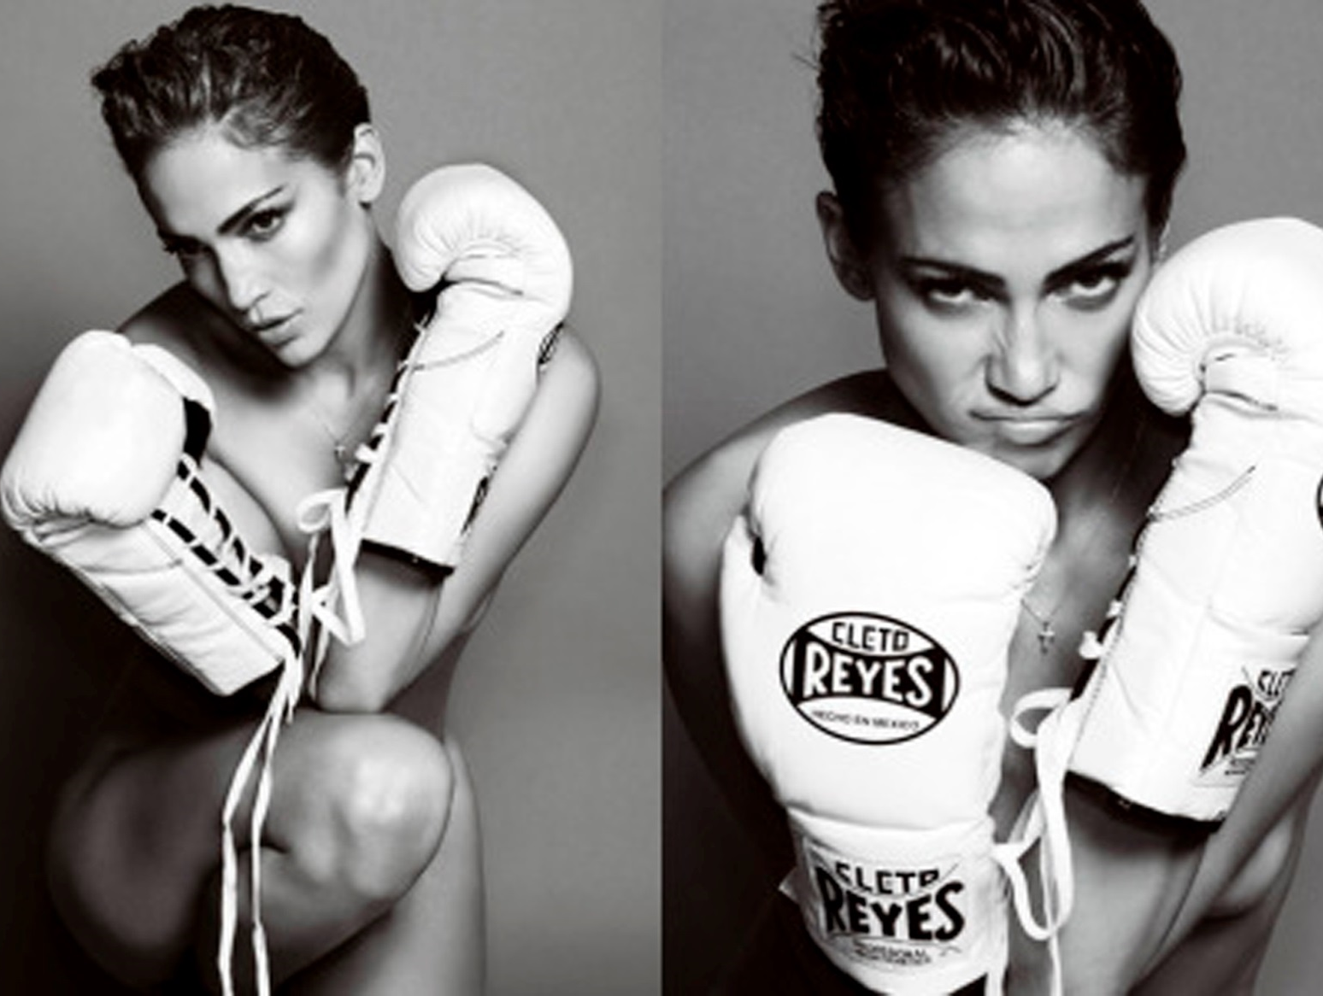
Jennifer Lopez - 2010
Notes:
Side by side photographs made into one picture.

Slide 6
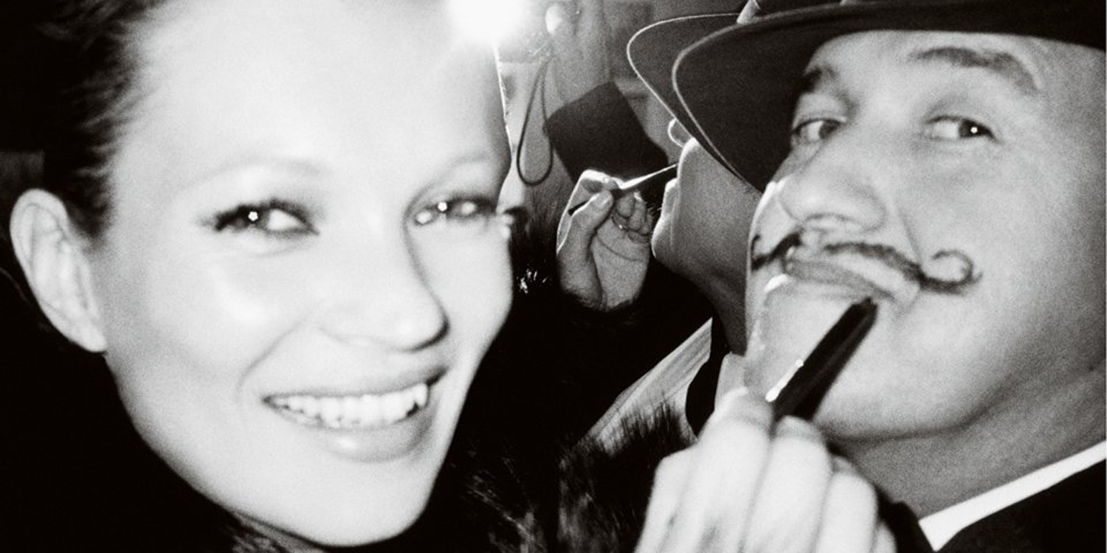
Kate Moss & Mario Testino
His book “Kate Moss by Mario Testino” is his tribute to his greatest muse.
Notes:
This is a selfie by Mario Testino –the camera is partly seen through the mirror.

Slide 7
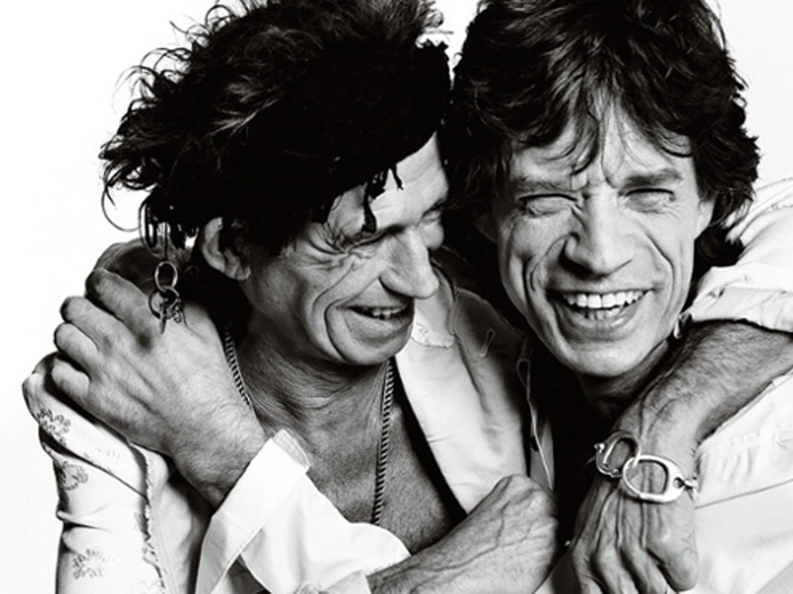
Brotherly shot of Keith Richard and Mick Jagger
From “Sir” by Mario Testino published in 2015
Notes:
“I was always better at men” said Testino, “but I realised the business was with women. So. I put all my energy on doing photographs with women but at the same time, I was photographing me all through my career.

Slide 8
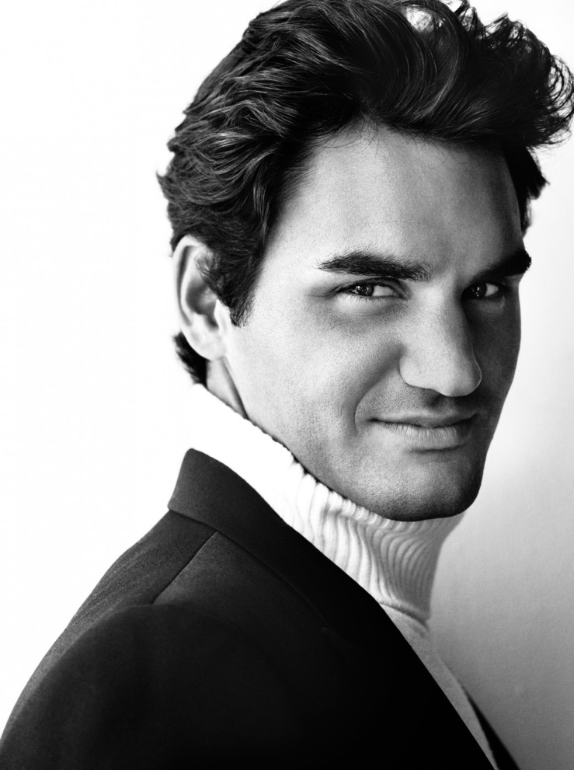
Roger Federer as seen in “Sir”
“I have always tried to give the sensation that you are getting special proximity to the subjects in my pictures, that you are getting to know what it is like to be right there with this amazing person.”
Notes:
One for the girls! Note the lighting…

